Slide 1
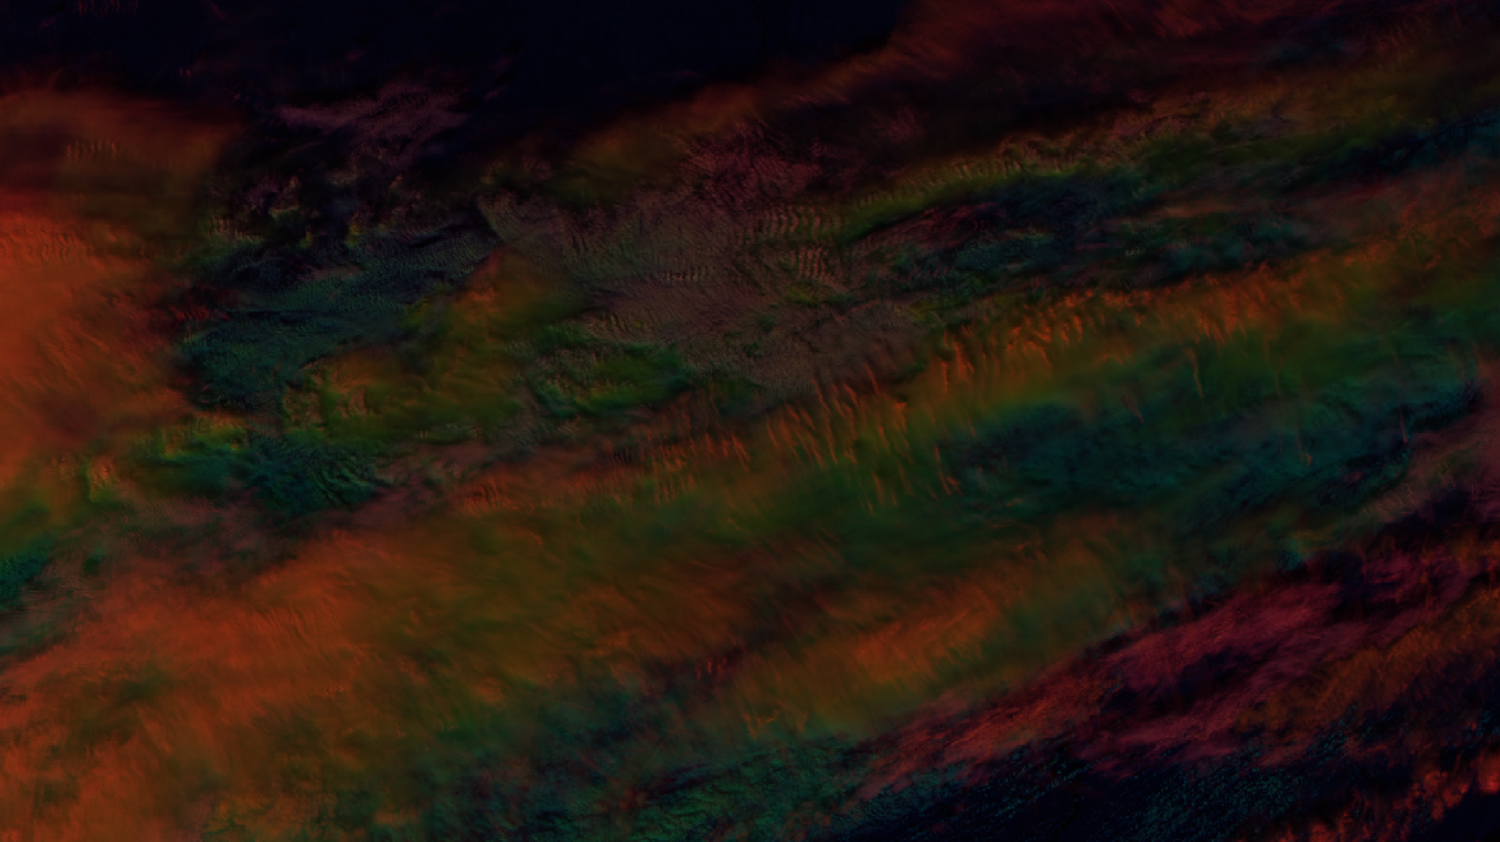
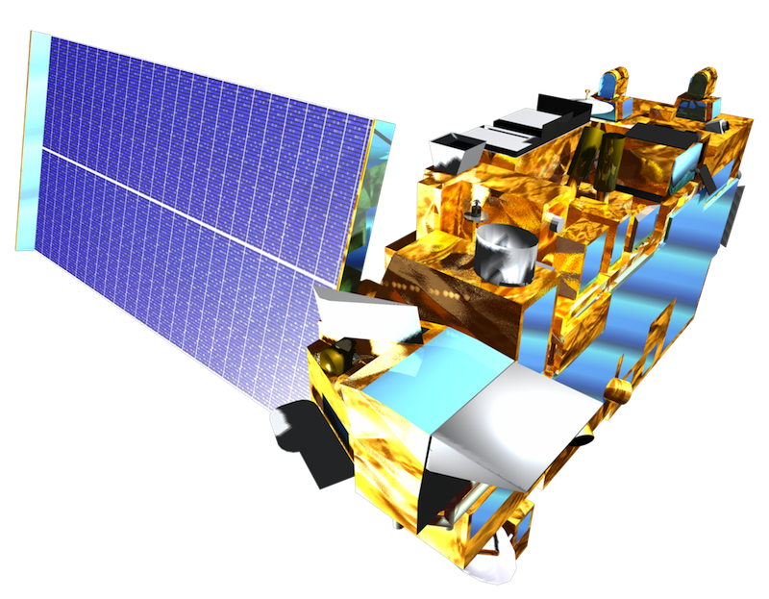

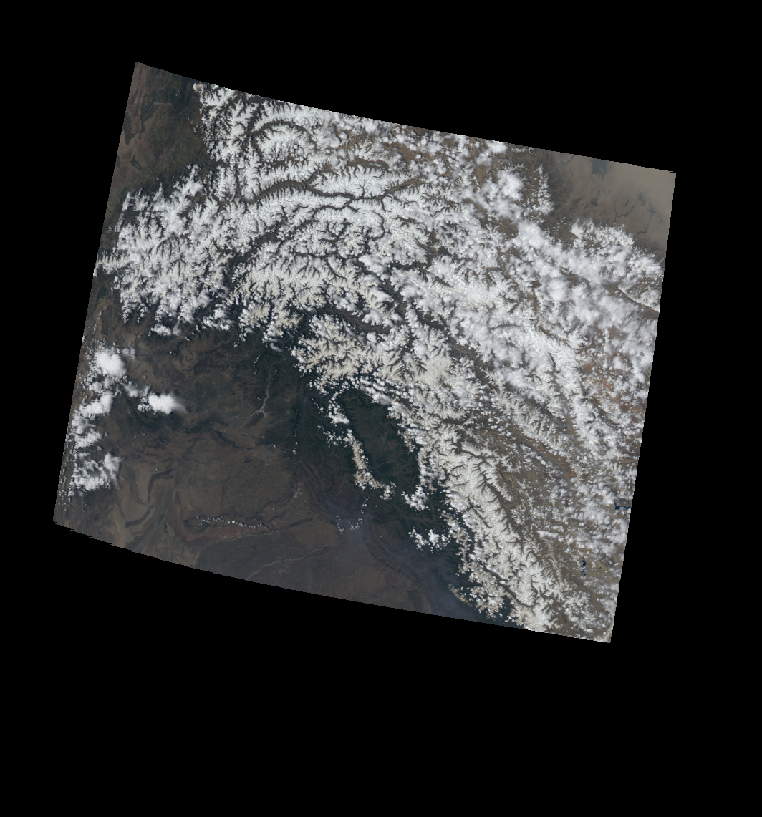
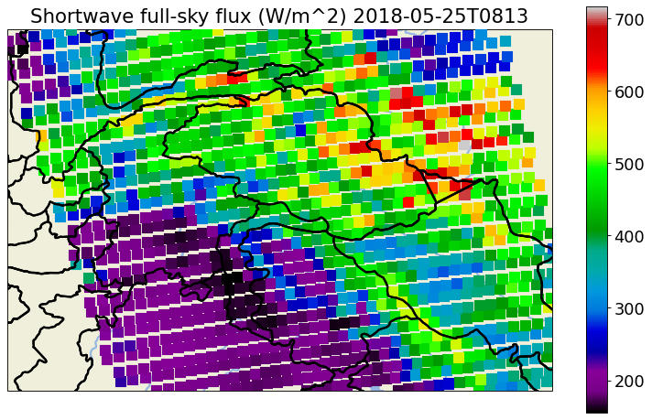
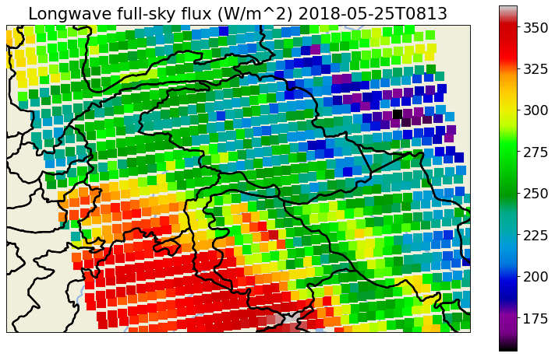
Estimating CERES-based Broadband Flux
from 1km MODIS observations
Presented by Mitchell Dodson
True Color
R:.64um G:.55um B:.45um
SZA
The EOS satellites Terra and Aqua carry a broadband sensor called CERES, and a 36-channel narrow-band sensor, MODIS.
CERES has ~16x24km resolution; MODIS has a ~1km² resolution.
Since CERES and MODIS can be directly co-located, my hypothesis is that the 1km MODIS pixels can be used to predict the broad-band fluxes observed by CERES at their finer spatial scale.
VZA
CERES SW (Y_{SW})
CERES LW (Y_{LW})
MODIS
P
Q

Slide 2
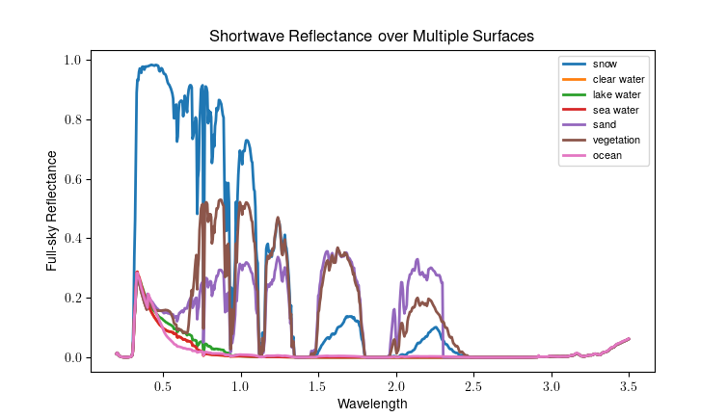
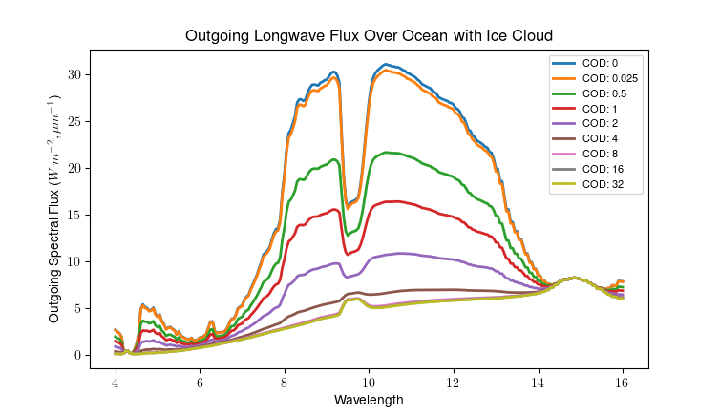
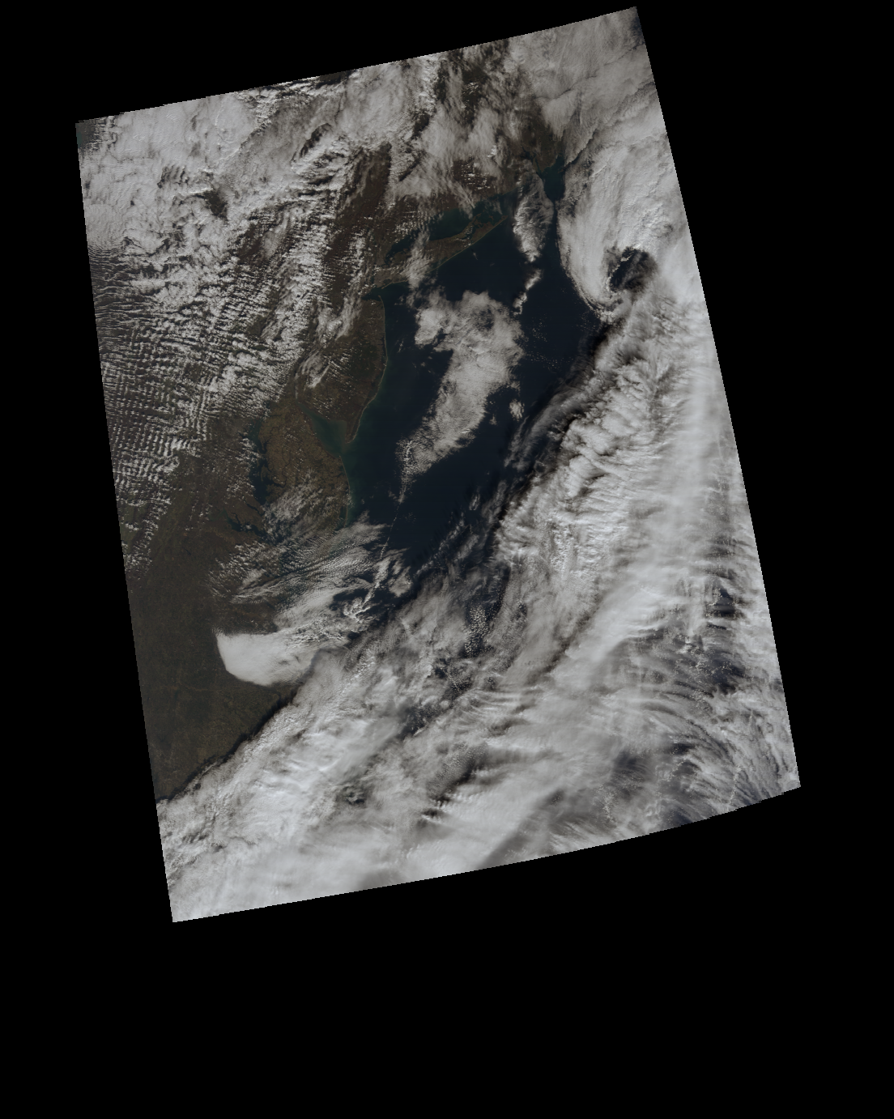
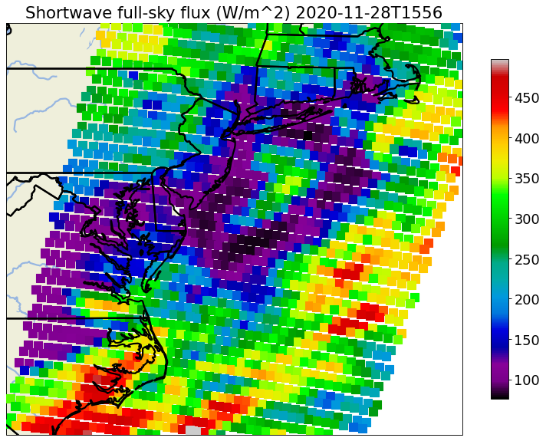
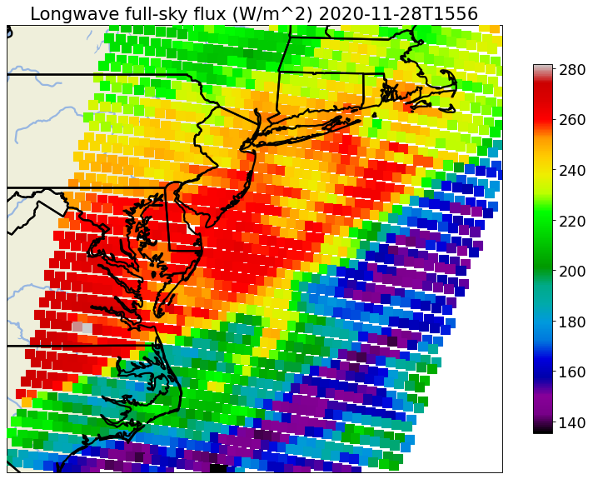
Flux versus spectral radiance
5 26 6
5 26 6
7
7
20
20
27 28 29
27 28 29
8 4 1 2 18
8 4 1 2 18
30 31 36
30 31 36
Flux: (W m⁻²) ; Spectral radiance: (W m⁻²um⁻¹sr⁻¹)

Slide 3
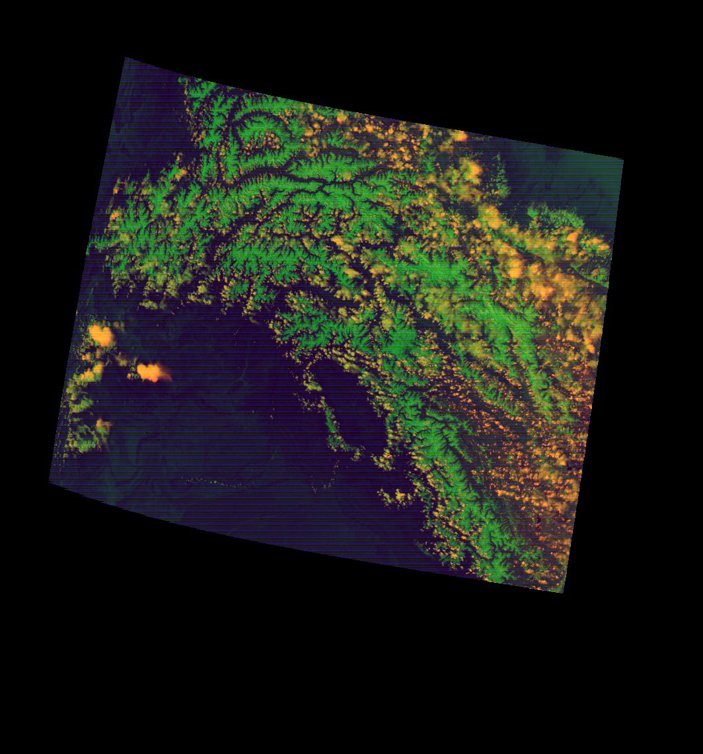
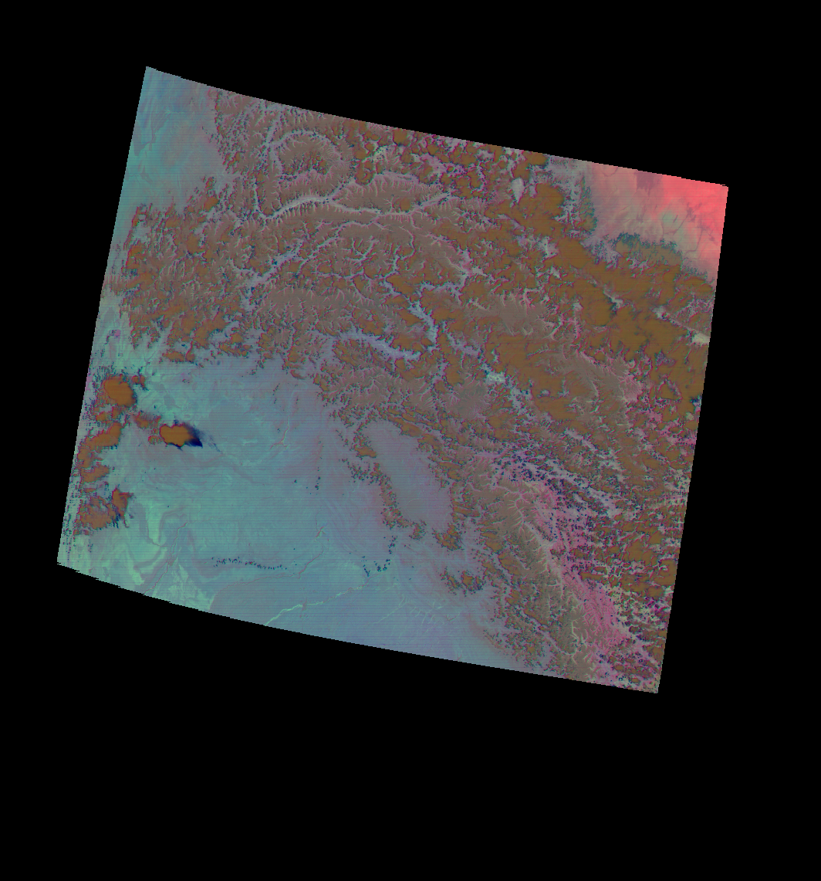
Hindu Kush Himalaya
lat:[32,38] lon:[69,79]
Day Cloud Phase
R:1.38um G:.64um B:1.6um
True Color
R:.64um G:.55um B:.45um
Dust
R:12-11um G:11-8.6um B:11um
Mountainous region including borders between Afghanistan, Pakistan, and Tajikistan
Common surfaces:
Year-round snow caps with seasonal variation in extent
Vegetation
Barren and desert land surfaces.
High-altitude clouds

Slide 4
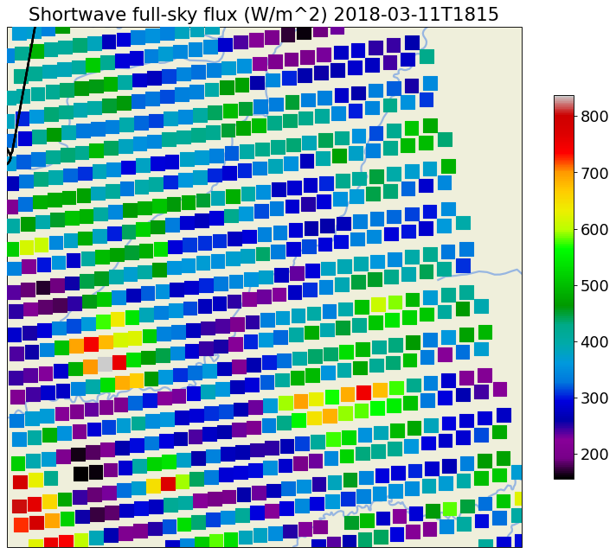
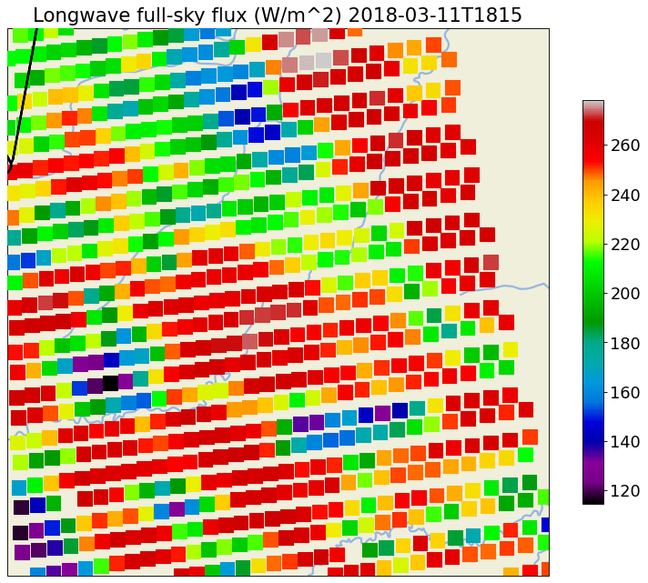
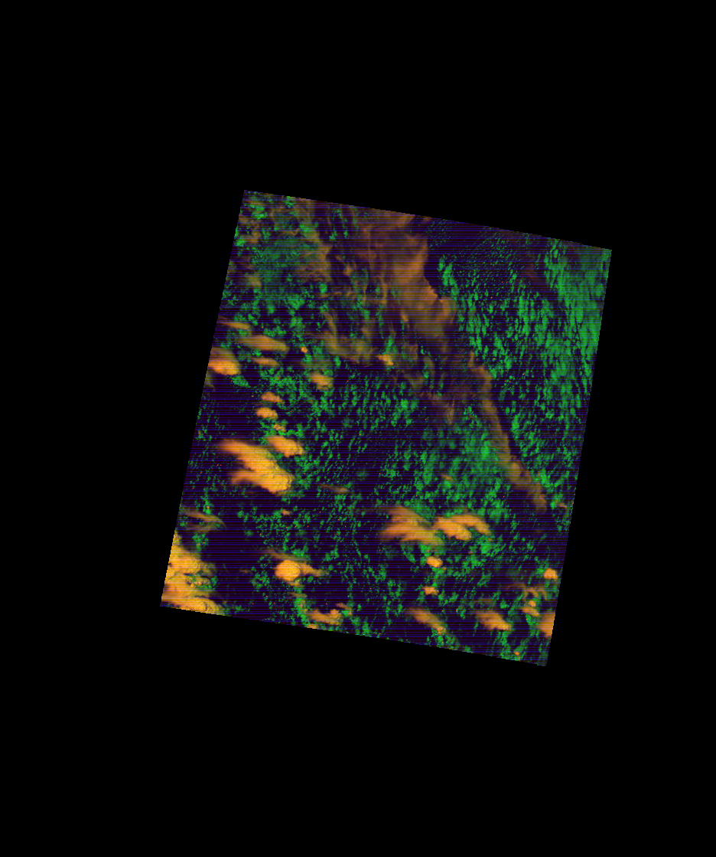
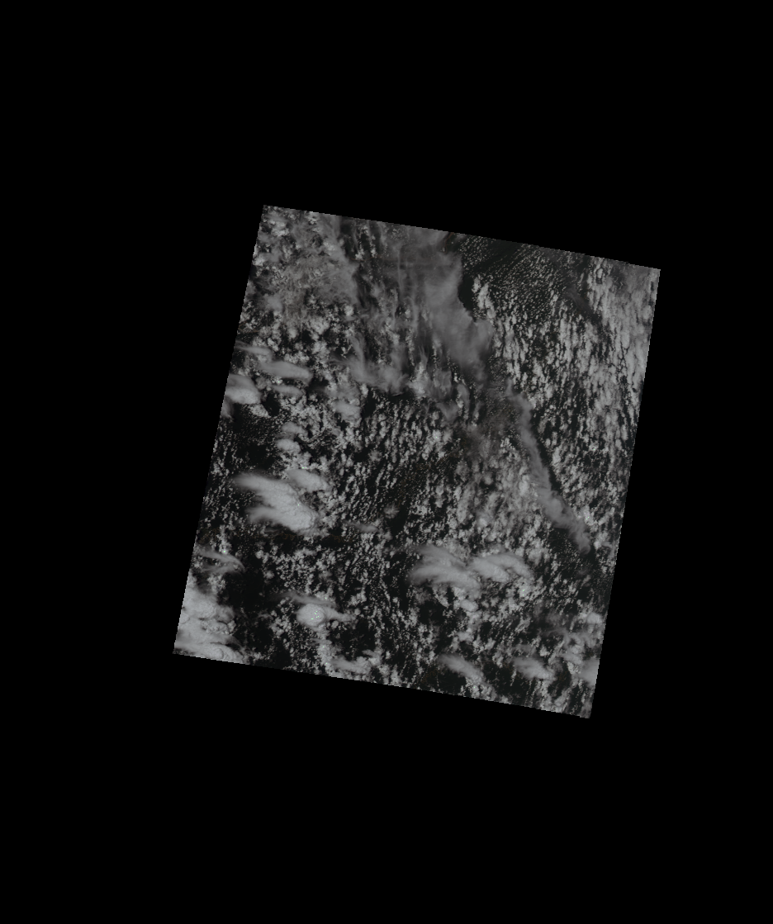
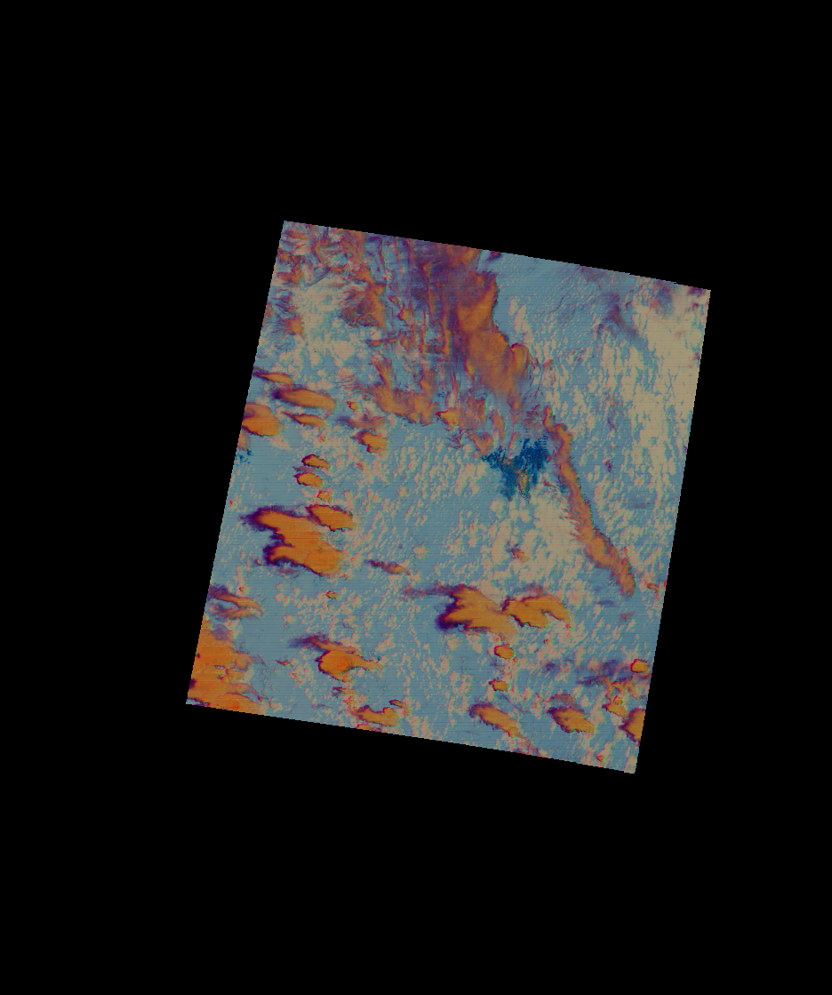
Amazon Rainforest
lat:[-3,-8] lon:[-65,-75]
Day Cloud Phase
R:1.38um G:.64um B:1.6um
True Color
R:.64um G:.55um B:.45um
Dust
R:12-11um G:11-8.6um B:11um
Densely forested and largely undeveloped region of Northern Peru, just south of the equator
Common surfaces:
Deep tropical convective systems
Numerous small cumulus clouds
Dense vegetated surfaces
Cirrus clouds
Biomass burning smoke

Slide 5
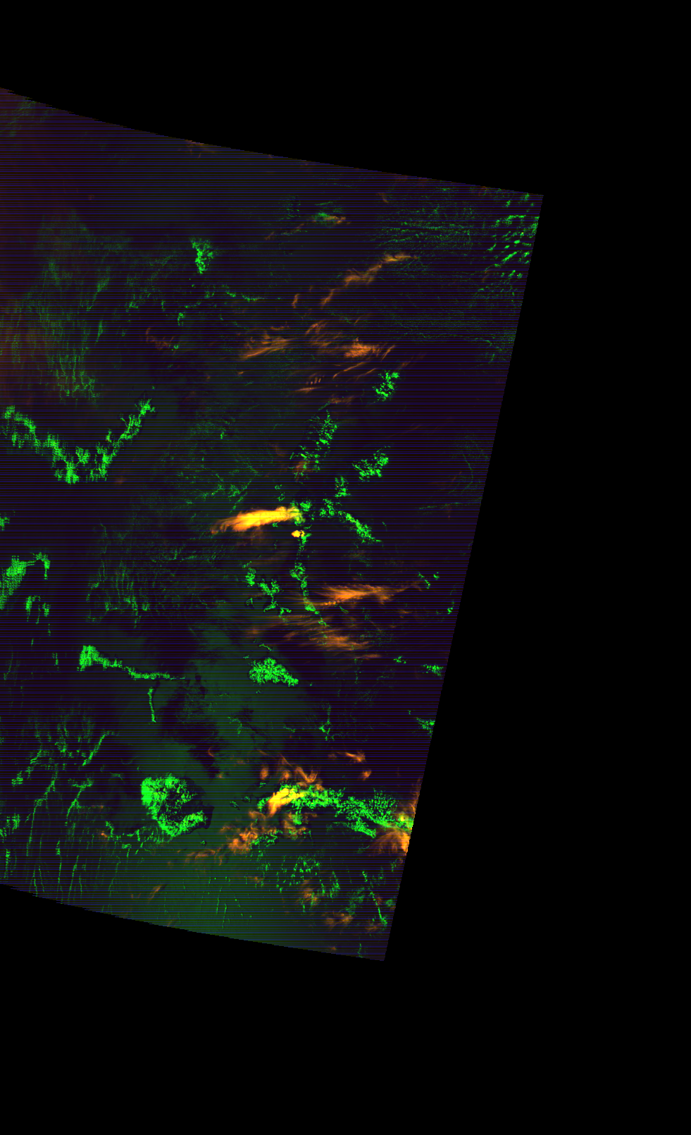
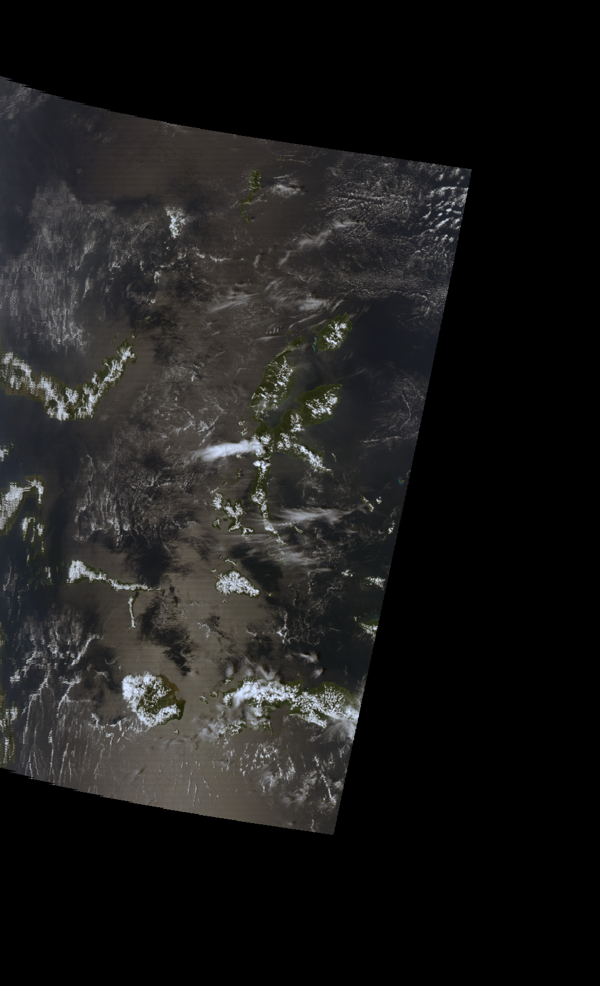
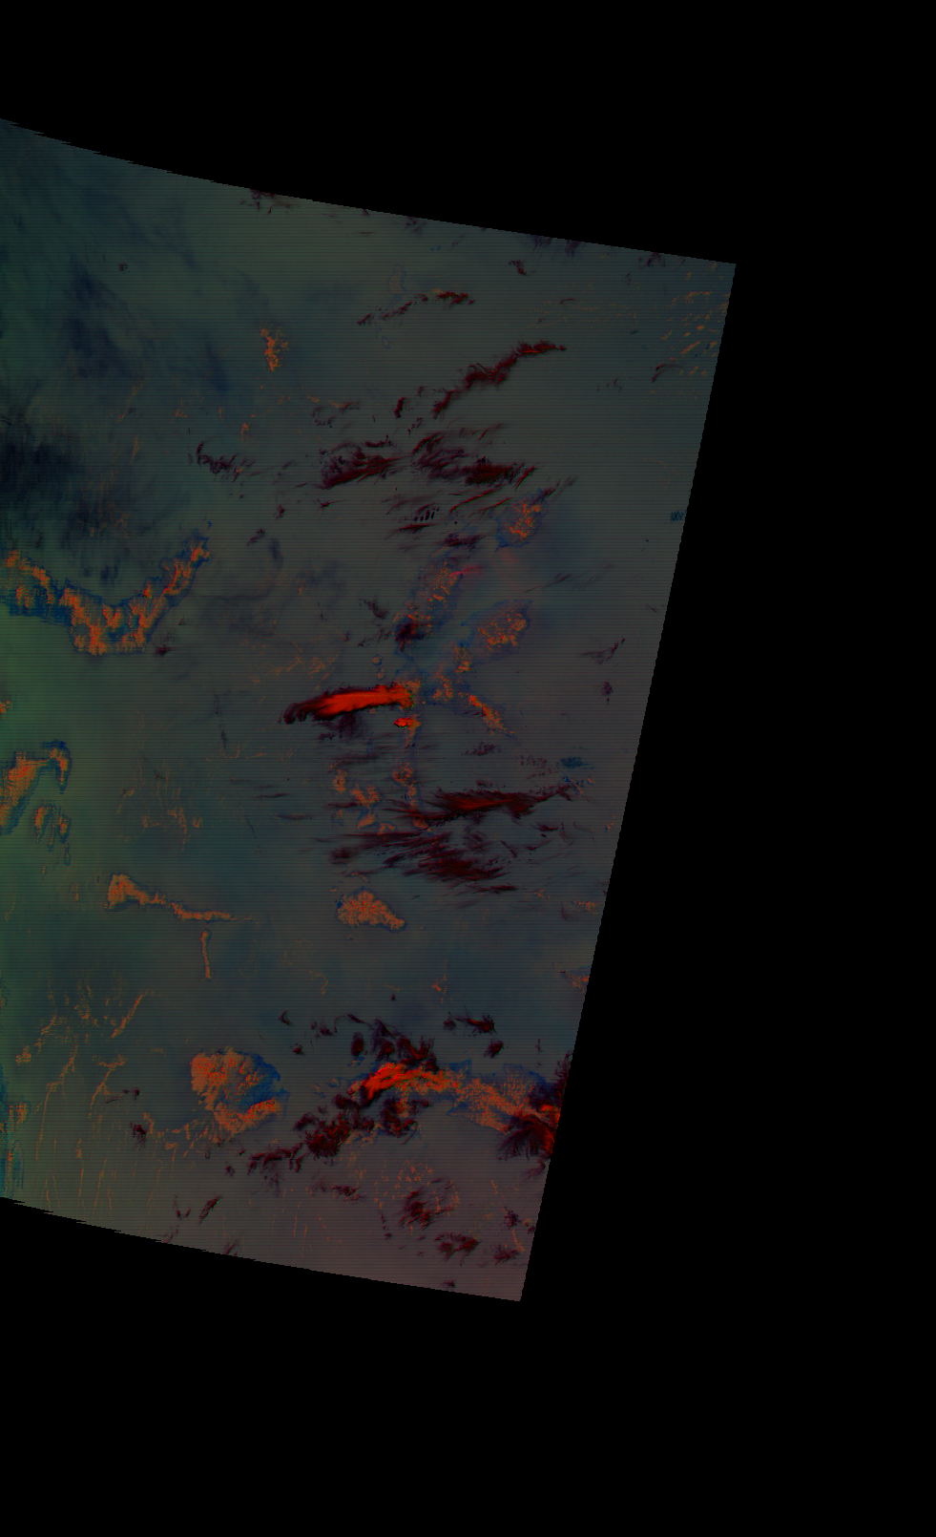
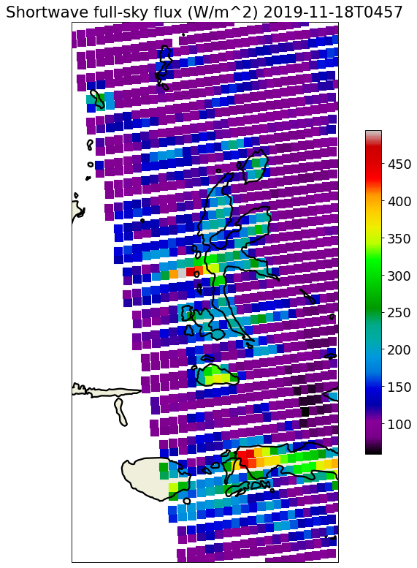
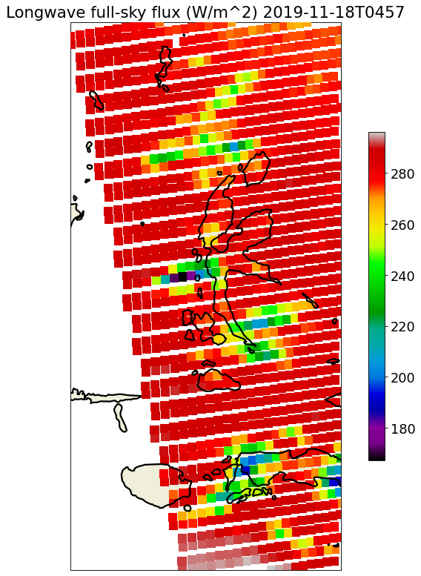
Indonesia
lat:[-5,5] lon:[120,130]
True Color
R:.64um G:.55um B:.45um
Dust
R:12-11um G:11-8.6um B:11um
Day Cloud Phase
R:1.38um G:.64um B:1.6um
Tropical oceanic region with several islands spanning the equator.
Common surfaces:
Water
Vegetation
Sun glint
Clouds of all varieties

Slide 6
Neural network architecture
Pixel-wise Method
Aggregate Method
Divergence:
D_{SW}= (P_{SW} - Y_{SW})²
D_{LW} = (P_{LW} - Y_{LW})²
P_{SW} P_{LW}
P_{SW} P_{LW}
PSF
ADM Decoder
SW,LW
Sharpened SW/LW
Shape: (P,Q,2)
z
Agg. Latent
Shape: (L,)
Pixel-wise Decoder
PSF
Z
Latent grid
Shape: (P,Q,L)
G
Z
Latent grid
Shape: (P,Q,L)
Pixel-wise
Encoder
Pixel-wise
Encoder
Copy along
axes
G
View Geometry
( SZA, VZA, RAA )
Shape: (3,)
G
View Geometry
( SZA, VZA, RAA )
Shape: (3,)
X
MODIS pixels Shape: (P,Q,M)
X
MODIS pixels Shape: (P,Q,M)

Slide 7
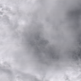
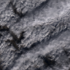
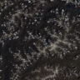
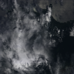
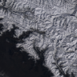
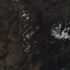
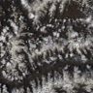
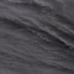
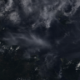
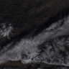


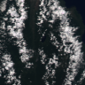
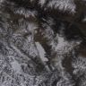
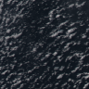
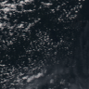
Questions?

